Slide 1
WUXI AI
07/01/2021
Brad Qiu

Slide 2
AGENDA
AI HISTORY
CONVOLUTION NEURAL NETWORK
SKYEYE OCR SYSTEM
PROBE TEST DETECT

Slide 3
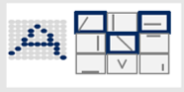
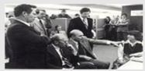
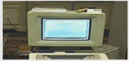
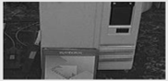
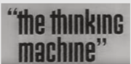
AI development experienced several false starts and ‘AI winters’ before it was revived again in the last decade
1956
1974
1980
1987
2010s
AI concept coined at Dartmouth workshop
Lighthill’s and ALPAC criticism on AI application
Commercial success of expert systems
Collapse of expert system machine market
Rise of machine learning techniques
1st boom
1st winter
2nd boom
2nd winter
New era
Heavily funded by government
Developed rapidly in logic theorem for general purpose
Limited computing power
Limited available database
Government and public cut funding for AI research
Specialization in specific knowledge field
Easy-programming
Wide commercial applications
High maintenance and expense of expert systems
Non-robustness
?
Notes:
AI as a concept has been around for ages… in fact, since the 1950s
In the early years, the birth of AI was followed by huge optimism – heavy government funding and rapid development in algorithms were hallmarks of this phase
But this optimism had raised expectations impossibly high, and when the promised results failed to materialize, funding for AI disappeared
80s brought together first useful applications: in the 1980s a form of AI program called "expert systems“, restricted to a small domain of specific knowledge was adopted
But lack of wide applicability of these systems was a major barriers
Over the past two decades, we have again seen the popularity of AI gain momentum—question is – will it be different this time?

Slide 4





Is this era going to be different? Better algorithms, improved hardware, increased data availability and AI-as-a-service
Algorithms: Deep neural nets and advanced deep learning methods have improved accuracy
Hardware: Massively parallel (Nvidia) and low-precision (Google) architectures have sped up hard compute
Human vs. Computer Error Rates in image classification, %
GPU Image/second Training Speed
Deep Learning
Human
Computer
2010
13
2017
2013
14
15
2016
Data availability: Availability of more data leads to higher accuracy
Al-as-a-service: Open access Al cloud compute platforms democratize access
Memory-based
Naive Bayes
Perception
Winnow
Accuracy, %
100
Amazon Lex
Google Cloud Translation
90
Google Cloud Speech-to-Text
80
Google Cloud Vision
70
Amount of data

Slide 5




Across advanced industrial companies, AI used to drive ROIC improvements across the tree
Illustrative, Not Exhaustive
Deep-dive follows
Revenue
Pricing
1
Self-learning pricing algorithm to dynamically optimize prices
2
ML-based predictive models to assess future demand-supply balance for pricing/ allocation
Volume
3
Lead management to prescribe sales approach, campaign for each customer
4
Sales war room for analytics-based steering of sales performance
5
Expanding TAM from products to solutions with AI / analytics-driven value-added product/ services
Pro- curement
6
Supply-chain optimization by reduce forecasting errors, enable lower inventory levels
Profit-ability
COGS
7
eRFx with automated analytics to enable large-scale market testing
8
Category-specific levers to dynamically quantify, visualize performance, savings opportunity
Manu-facturing
9
Advanced analytics for yield management in a semiconductor fab
10
Process automation in manufacturing line (e.g., OCR for wafer tracking, fab automation)
11
Automated in-line inspection / metrology (e.g. defect detection + classification) with image recognition
12
Predict failure modes + predictive maintenance (e.g., bearing changes) to improve fab uptime
R&D
13
Reinforcement learning to automate place-and-route in chip design
14
Analyzing and improving effectiveness of R&D investments
15
Learning-based DfX (e.g., design for manufacture / test / value / yield)
Opex
16
AI-based circuit design services based around vendor products
17
ML-based EDA (e.g., OPC, library characterization, CMP modeling, lithography simulation)
G&A
18
AR optimization through invoice-level recommendation engine for collections
19
RPA for repetitive tasks to reduce errors, speed up insights (e.g., forecasting)
20
Process mining to reduce overhead in finance, order processing
Notes:
ML EDA: https://www.electronicdesign.com/industrial-automation/article/21120058/mentor-a-siemens-business-eda-in-the-era-of-ai
Process mining: https://www.mckinsey.com/industries/automotive-and-assembly/our-insights/how-industrial-companies-can-cut-their-indirect-costs-fast

Slide 6
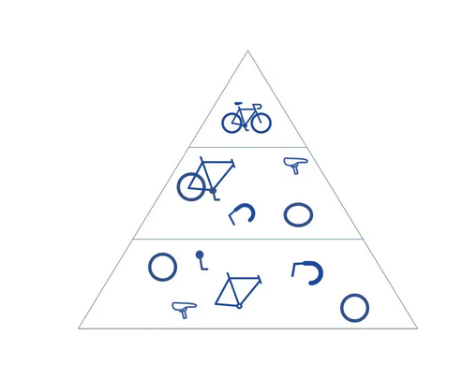
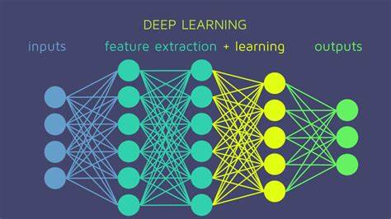
CONVOLUTIONAL NEURAL NETWORKS
IBM define :
Convolutional neural networks are distinguished from other neural networks by their superior performance with image, speech, or audio signal inputs. They have three main types of layers, which are:
Convolutional layer
Pooling layer
Fully-connected (FC) layer
WE define:
CNN is a algorithm which can offer computer vision ability. The vision ability is shown on two aspect: image classify, image object detect
Notes:
SHOW CNN,REST_NN

Slide 7
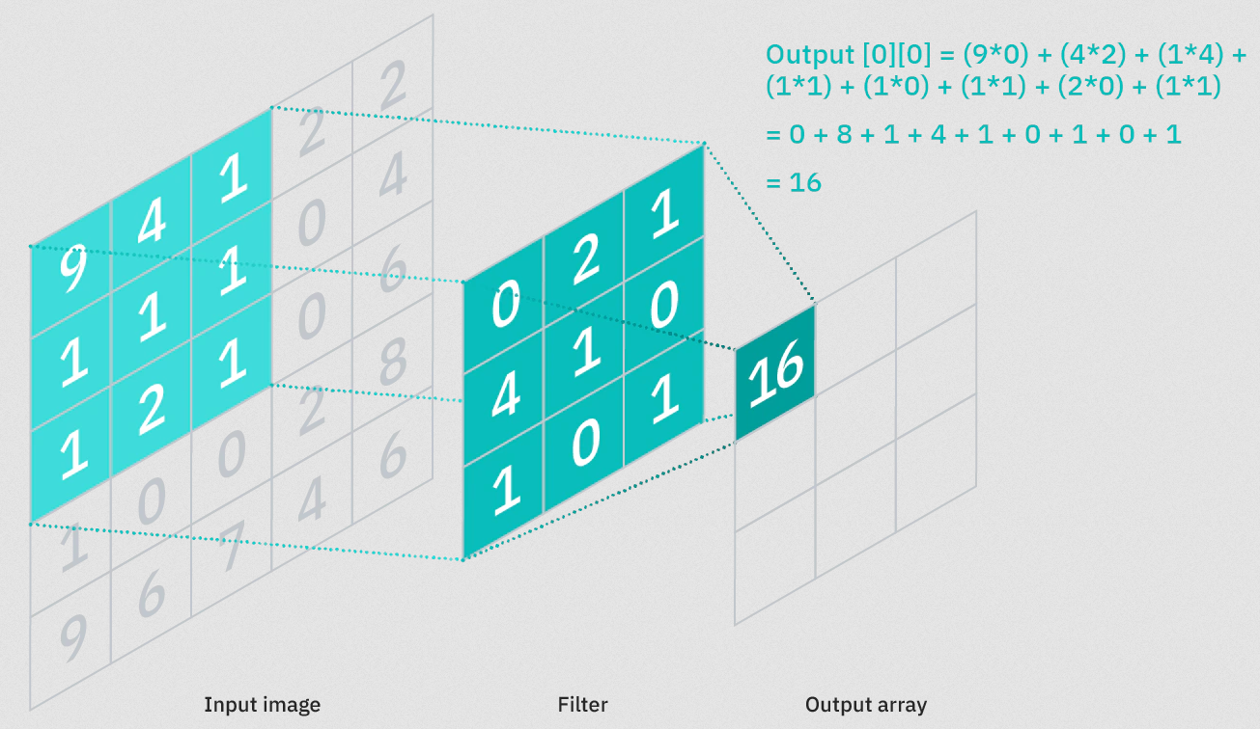
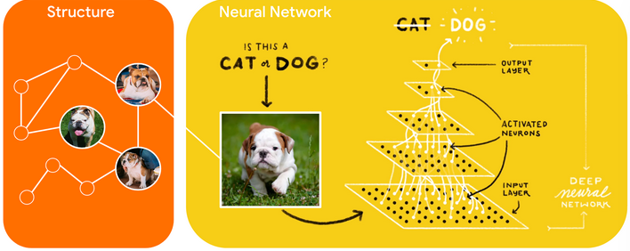
HOW CNN WORK
Train Data
train
CNN
save
AI-MODEL
Filter is the weight of each neural unit. The weight generate by training AI model.

Slide 8
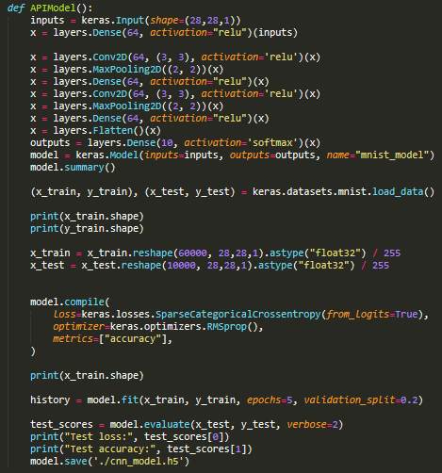
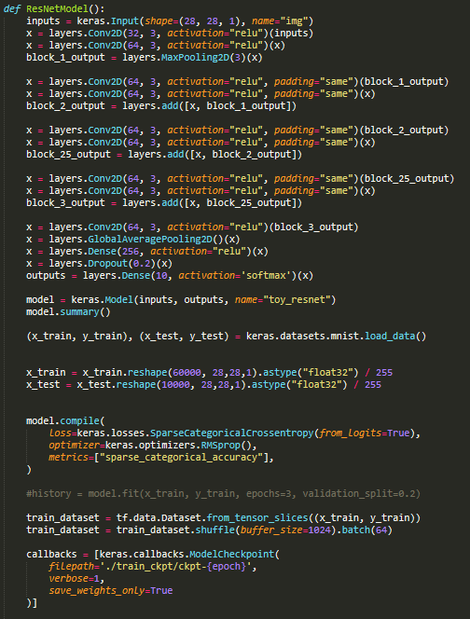
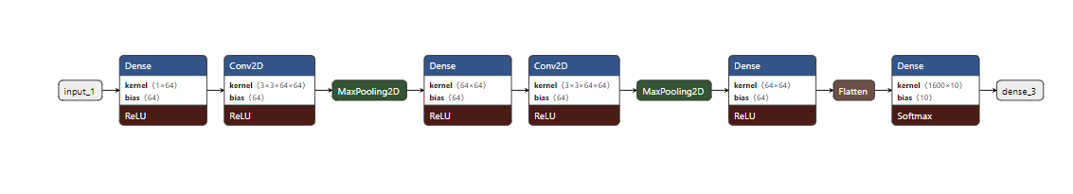
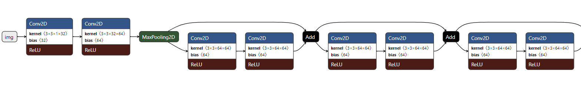
TENSORFLOW CNN CODE

Slide 9
SKYEYE OCR SYSTEM
OCR - OPTICAL CHARACTER RECOGNIZE
SKYEYE OCR SYSTEM – When we do wafer accept test, I developed an OCR system, SKYEYE, to recognize coordinate of VCSEL chip. With AI technology, SKYEYE has a 99+% baseline accuracy. The system has run for two years and offered 400K pcs image recognize service. At performance aspect, SKYEYE has a 30 images per second throughput.

Slide 10
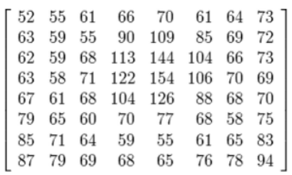

OCR THEORY
IMAGE-LABEL KNOWLEDGE LIBRARY
AI(TENSORFLOW)/ML (KNN,SVM)
AI model
OUTPUT
3

Slide 11

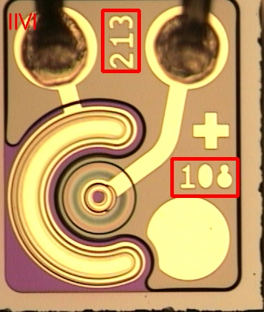
SKYEYE IMAGE CAPTURE PROCESS
VCSEL IMAGE
DETECT VCSEL TYPE
CAPTURE COORD
SPLIT CHAR IMAGE

Slide 12
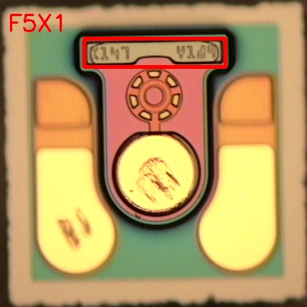
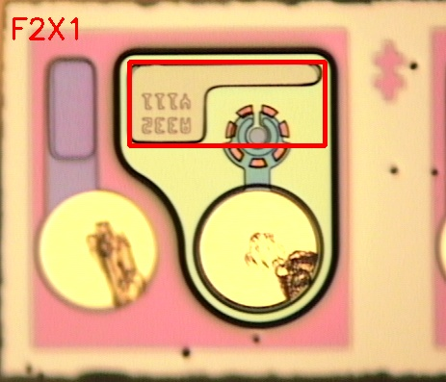
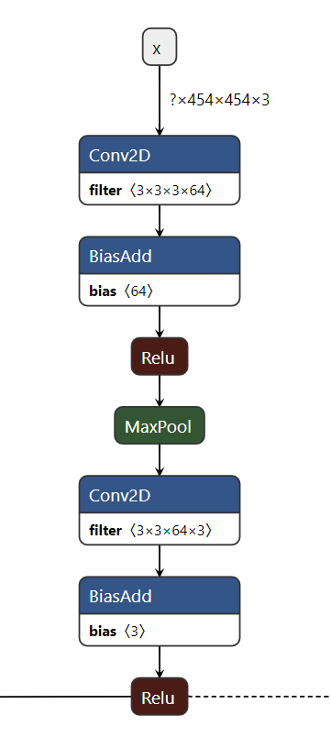

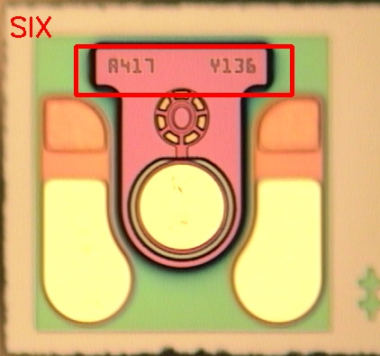
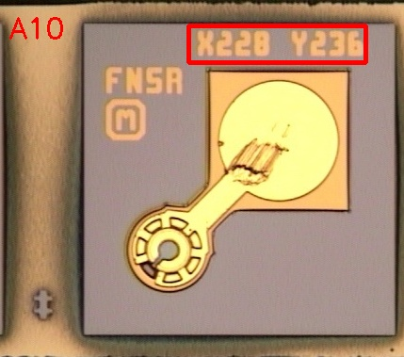
SKYEYE VCSEL TYPE AI DETECT
AI Demo: http://wuxinpi.chn.ii-vi.net:9091/Main/VCSELAIDemo

Slide 13
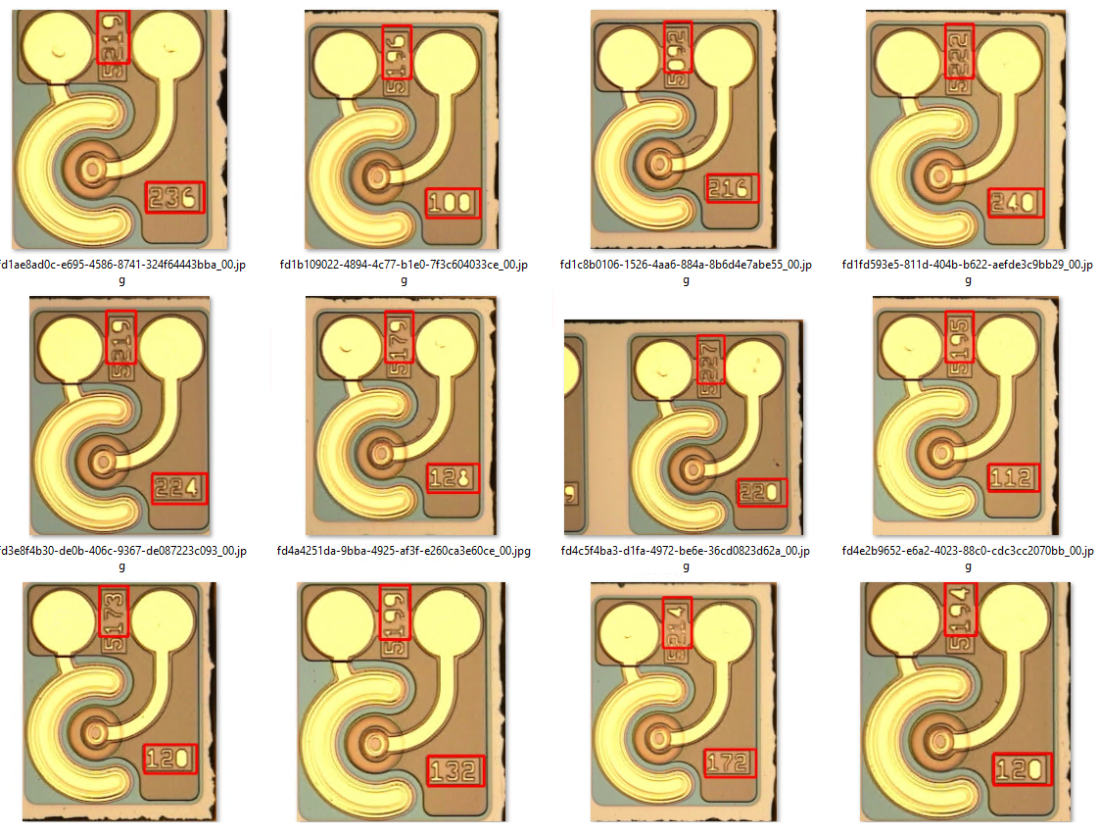
SKYEYE CHIP ID DETECT & LOCK
150 VCSEL images , 100% detect , 100% lock

Slide 14
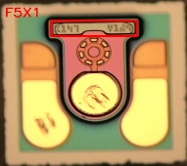


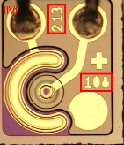
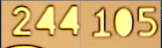
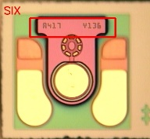

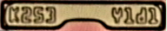
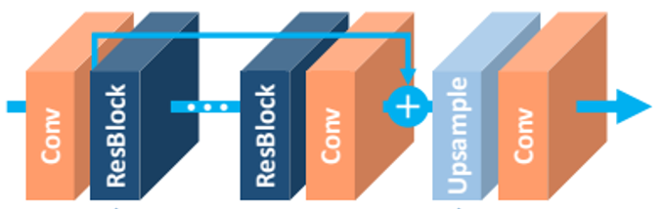
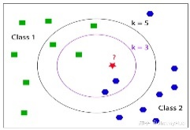
SKYEYE OCR TRAINING PROCESS
TENSORFLOW AI/CNN MODEL
Training Database
Label Image As 2
ML/KNN MODEL

Slide 15
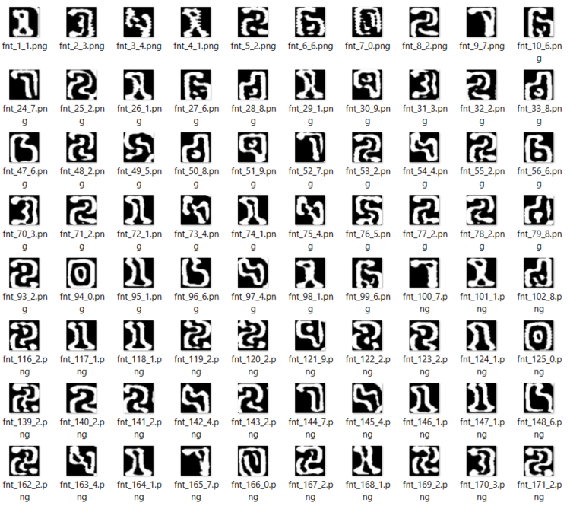
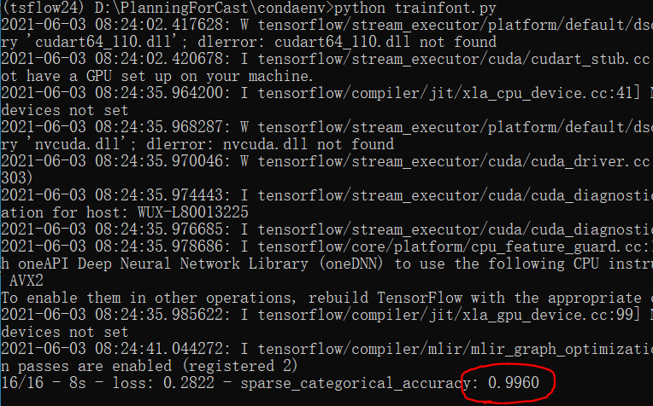
SKYEYE CHARACTER RECOGNIZE ACCURACY
500 character images recognize accuracy is 99.6%.

Slide 16
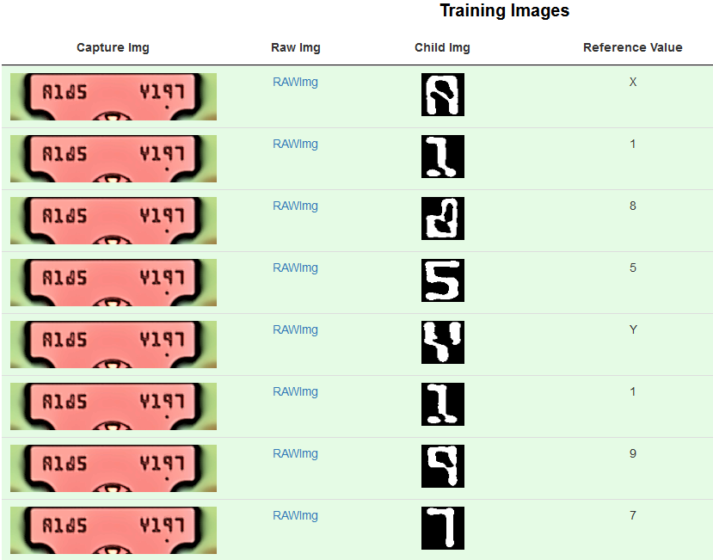
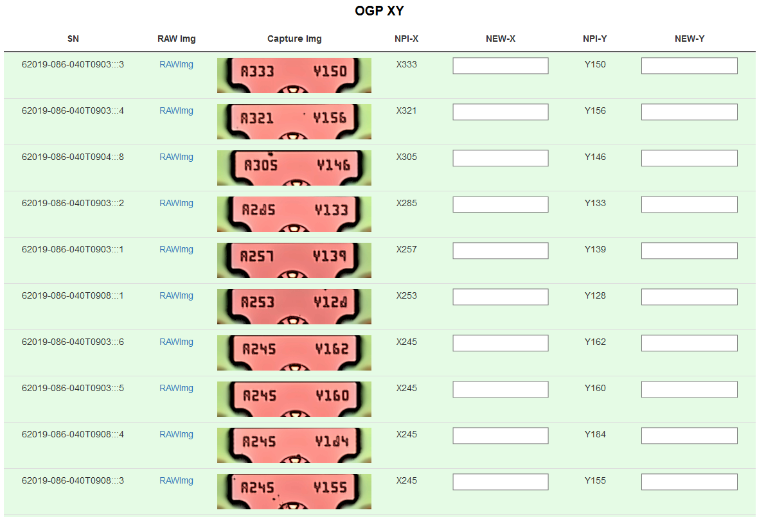
SKYEYE WEB SERVICE
SKYEYE offer OCR service by website, so it can be shared to other II-VI site easily by HTTP protocol. Demo offered by http://wuxinpi.chn.ii-vi.net:9091/OGPXY/OGPXYProfessionReview( input 293101-50E )

Slide 17
SKY EYE ADVANTAGE
Comparing | Commercial OCR | SKY EYE OCR
COST | $10K+ / LICENSE | $0
CORRECTIVE RATE | 85% | 99+%
PERFORMANCE |  | 30 images per second
PROJECT |  | WAT Test / 400G parallel
EXTEND |  | SKYEYE’s object detect function can be used to detect VCSEL surface defect

Slide 18
PROBE TEST DETECT

Slide 19
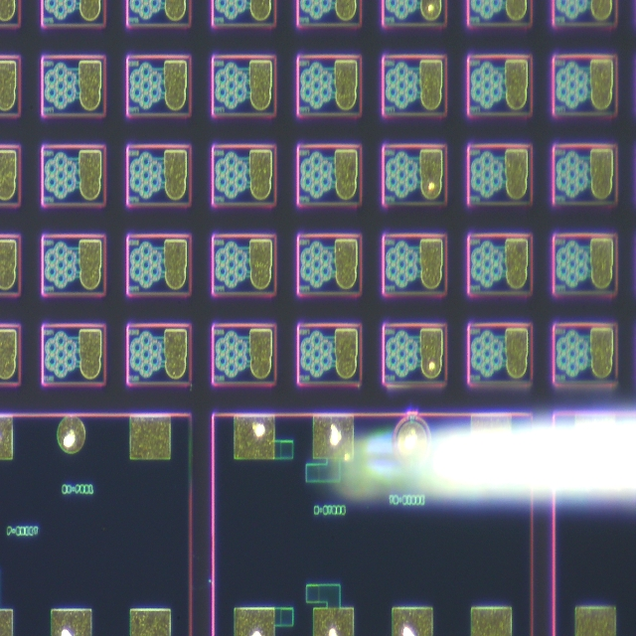
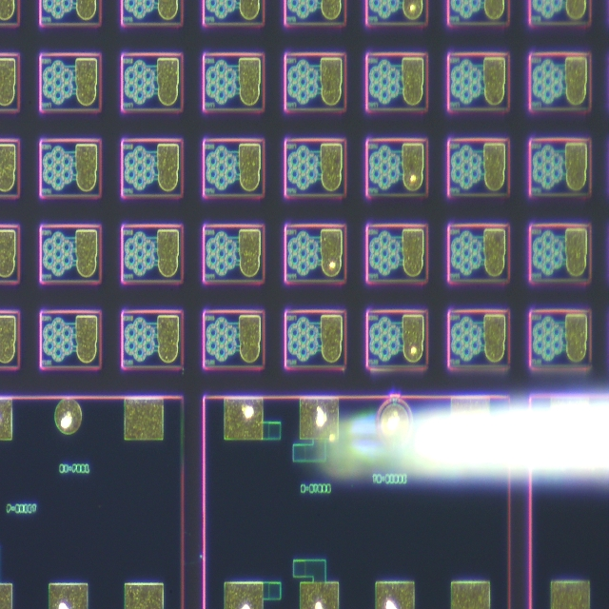
AI SOLUTION: CHECK WHETHER CHIP BE TESTED 1
Before Test
After Test

Slide 20
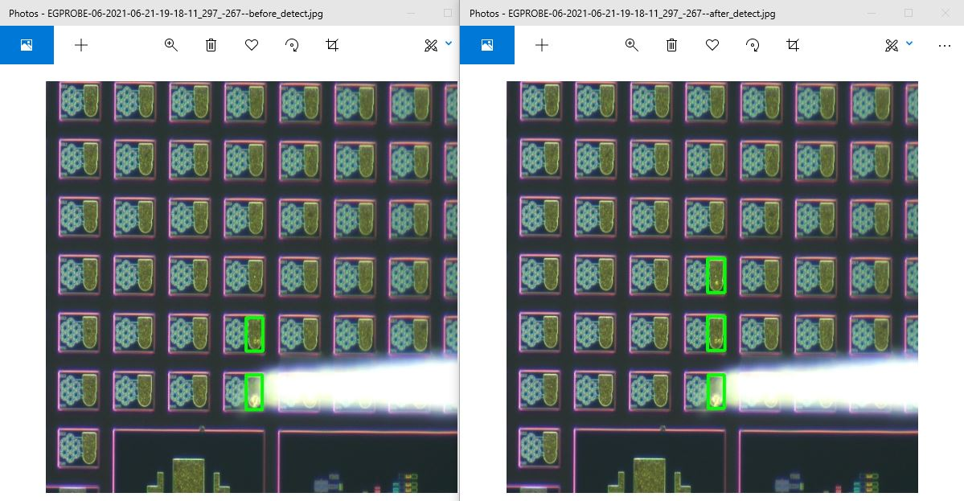
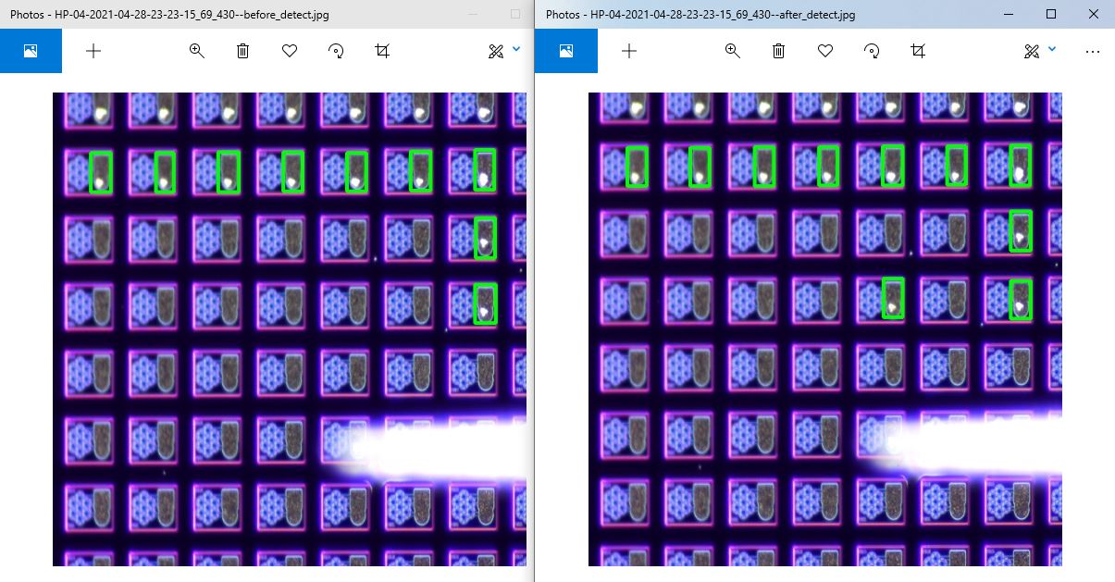
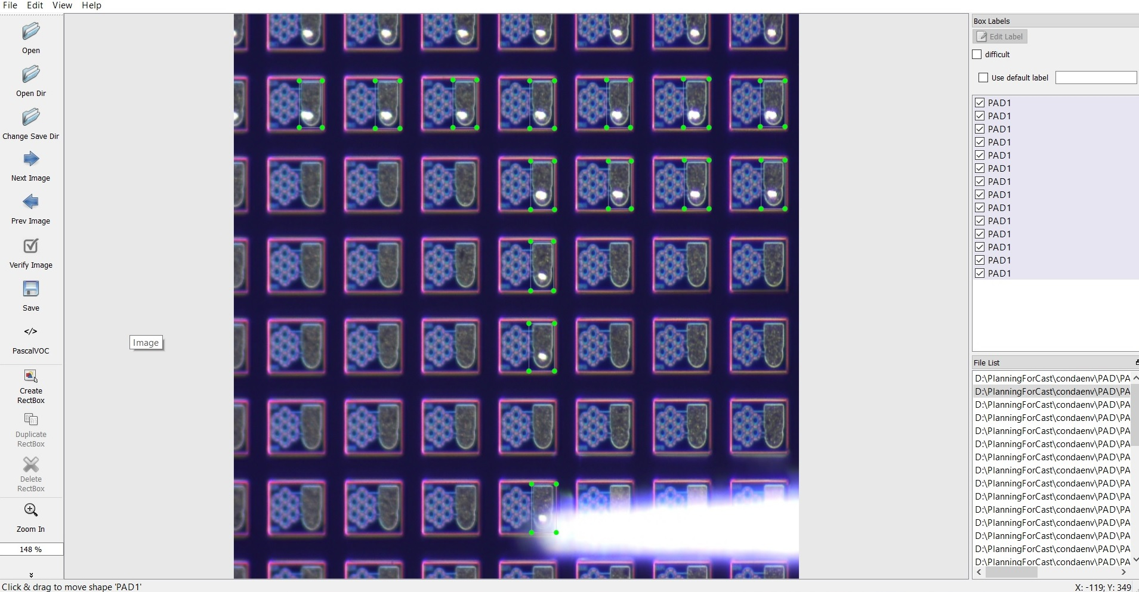
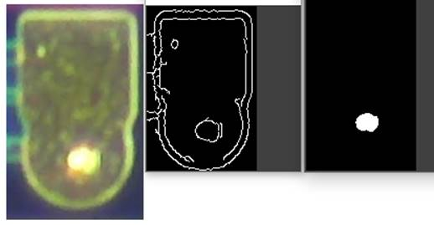
AI SOLUTION: CHECK WHETHER CHIP BE TESTED 2

